Slide 1

Microsoft PO & POE process Muhammad Tariq – Partner Marketing & Enablement Program Manager
About UAE
Area: 83,600 km²
Population : 9.5M
States: 7
GDP: 732 billion

Slide 2

Microsoft PO process
SLA 48
Hour
After JMA Exhibit
Signature
SLA 4-5 days
Within 2 weeks after activity completion
PO Approved & Partner can start the activity on due date
Submit Proposal to Microsoft
JMA & Exhibit will be created & sent for signature
PO will be raised
Submit Poe’s & invoice
Notes:
© Copyright PresentationGO.com – The free PowerPoint and Google Slides template library

Slide 3
Proposal to Microsoft
Marketing activity supported by 3rd party invoice |  | Expected Leads | Start Date – End date | Investment | ROI
Digital Marketing: | 3rd party invoice needed
Telemarketing: | 3rd party invoice needed
Partner Enablement: | 3rd party invoice needed
Events/ Webinar: | 3rd party invoice needed
Marketing activity supported by rate card tactic ( in-house activities)
Customer Demo: | 500$ / Demo
Customer Workshop: | 1500 $ / Workshop
Telemarketing: | 200$/ agent per day
Exhibit

Slide 4
Poe’s & Claiming Payment
Partner to Share Poe’s with PO Owner copying JMA specialist for 1st review and feedback sharing to ensure Poe’s aligned with JMA exhibit terms and conditions.
Once PO owner & JMA specialist agree on the Poe’s; they must email the partner to:
Upload the invoice directly on MSInvoice (MS invoice)
Invoice will reflect on the system after 48hrs,
Within 30-60 days compliance team with have final review for the Poe's as per shared internally by PO owner & JMA specialist.
***If any comments from compliance PO owner Or JMA specialist to share back and ask for partner clarification on raised comments.

Slide 5
POE example for few activities

Slide 6
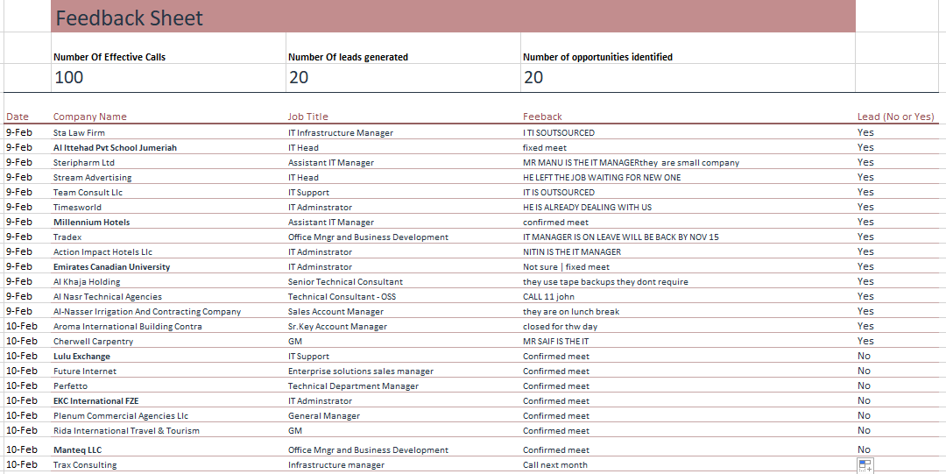
Tele Marketing (in-house)
Tele Feedback Sheet

Slide 7
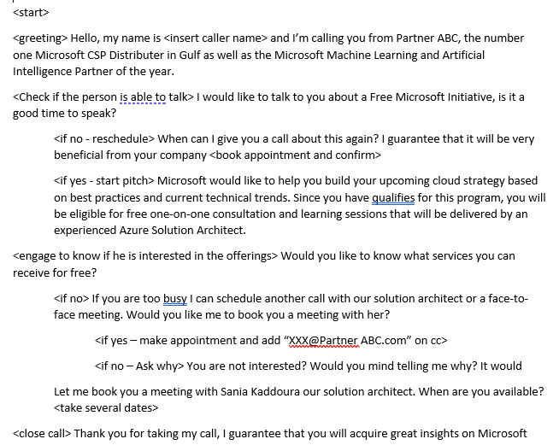
Tele Marketing (in-house)
Call Script

Slide 8
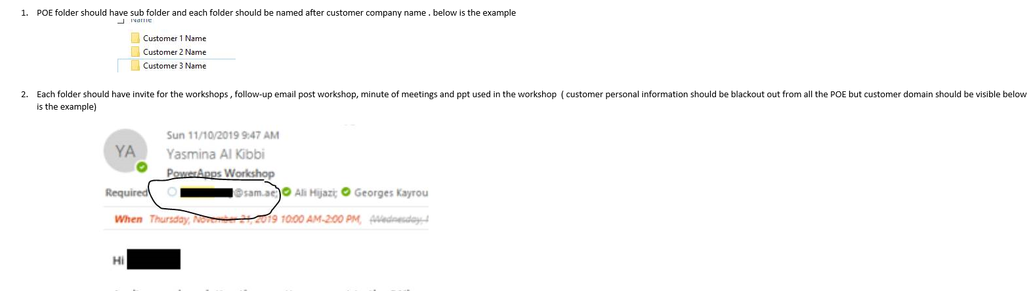
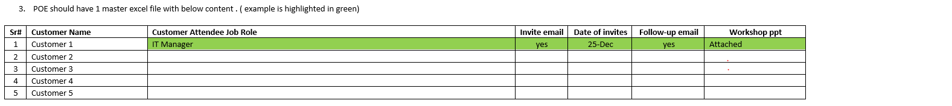
Customer Demo

